Slide 1
REA: Virtual Realtor
Jason, Aidan, Matt, Elliot, Mara
Notes:
Matt: Are you looking for a new home? Don’t really know where to start? Need someone to talk to? Don’t fret! REA is here. REA is your virtual real estate agent that helps you find a perfect home tailored to your own personal needs. REA is here to answer all your questions and concerns you have about buying a new home.
Person1: I am a 74-year old looking for an apartment to retire in. Show me a list of cheap apartments under 200k that is close to public transportation.
Realtor.ca shows no results
Matt: Just talk to REA about what you’re looking for and it will curate the perfect list of homes for you. Let’s have a chat!
Show results on Virtual Realtor
Results in `SELECT * FROM listings WHERE price <= 500000 and building_type in ('Apartment')`
Person2: Oh my goodness! That looks cool! Can i try that?
Person2: I am a single mother with 3 kids. I am looking for a single detached home with a huge backyard for my kids to play in. I need to live in a safe neighborhood with close access to a school and a playground
Show results on Virtual Realtor
<add more prompts for more bedroom?>
Person2: You are awesome REA
Results in `SELECT * FROM listings WHERE property_type in ('Single Family') and building_type in ('House') and (ammenities like '%Schools%' or ammenities_nearby like '%Schools%' or ammenities like '%Playground%' or ammenities_nearby like '%Playground%')`
<Live demo>

Slide 2
Our mission
Help simplify the search of your perfect home that suits your needs and preferences.
Notes:
Who is REA. Your virtual realtor. Real human interaction no filter required

Slide 3
Why Virtual Realtor?
Advanced Search Options: Filter properties based on your desired criteria.
Interactive Map: View properties on a map and explore neighborhoods.
Property Details: Access detailed information, photos, and virtual tours.
Real life Sales Data: Access up-to-date sales data to make informed decisions and understand market trends.
Notes:
Packed with features advanced search, interactive map and many more features. It is fun, backed by real life data and most important of all interactive experience .

Slide 4
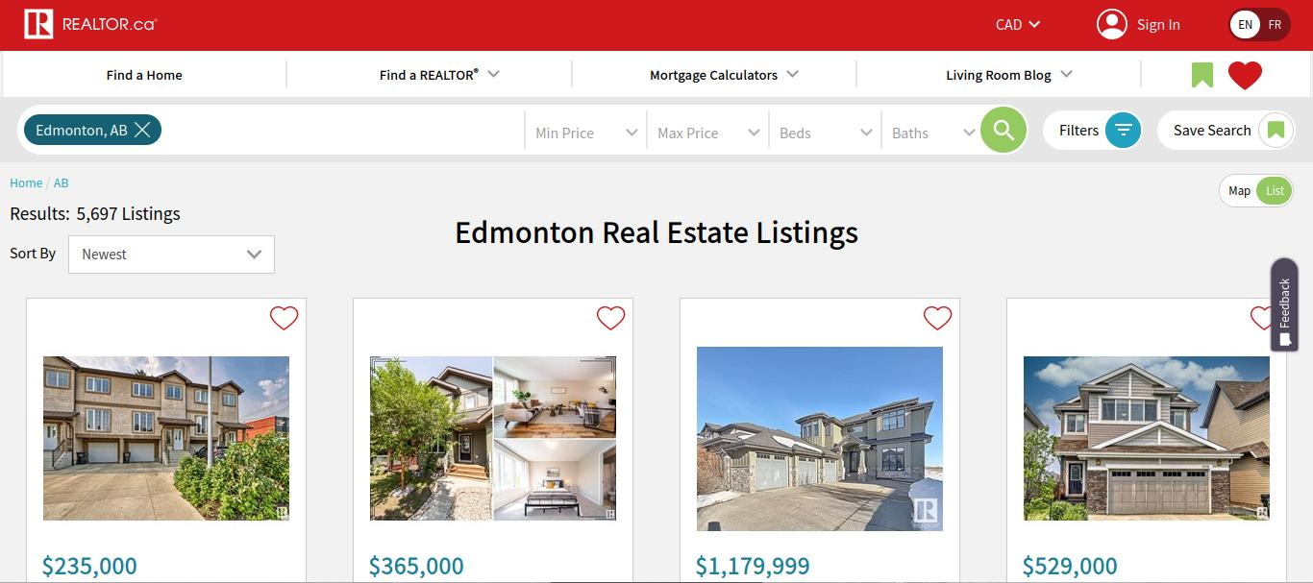
Interface
Notes:
Current real estate websites exist, such as this one, which provide text box filters for the user to manually enter values into. Feeling out these filters can be intimidating for users. These websites are also rigid, uninspired, and only provide the user with a very barebones experience.

Slide 5
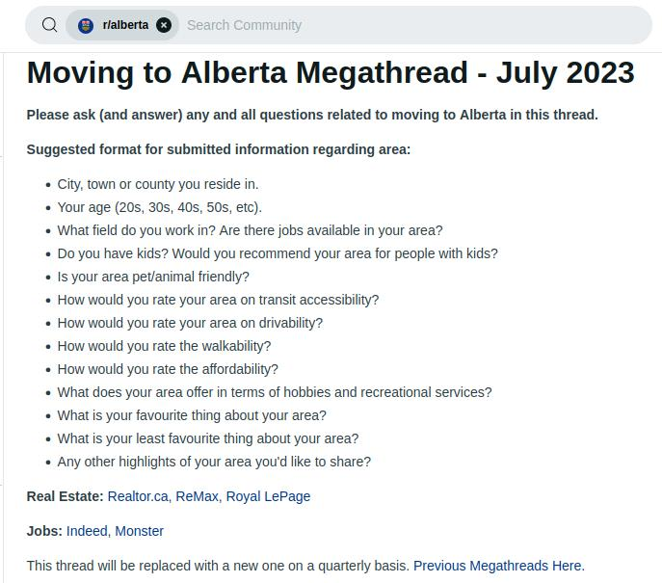
Interface
Notes:
People often resort to sites like Reddit when they get frustrated with these sites in order to find better answers to their housing needs. People are complicated and every individual has their own personal needs. Everyone has their own unique life situations, which a simple filter interface won’t account for. People want to have a conversation with someone, and current real estate websites don’t provide that to people.

Slide 6
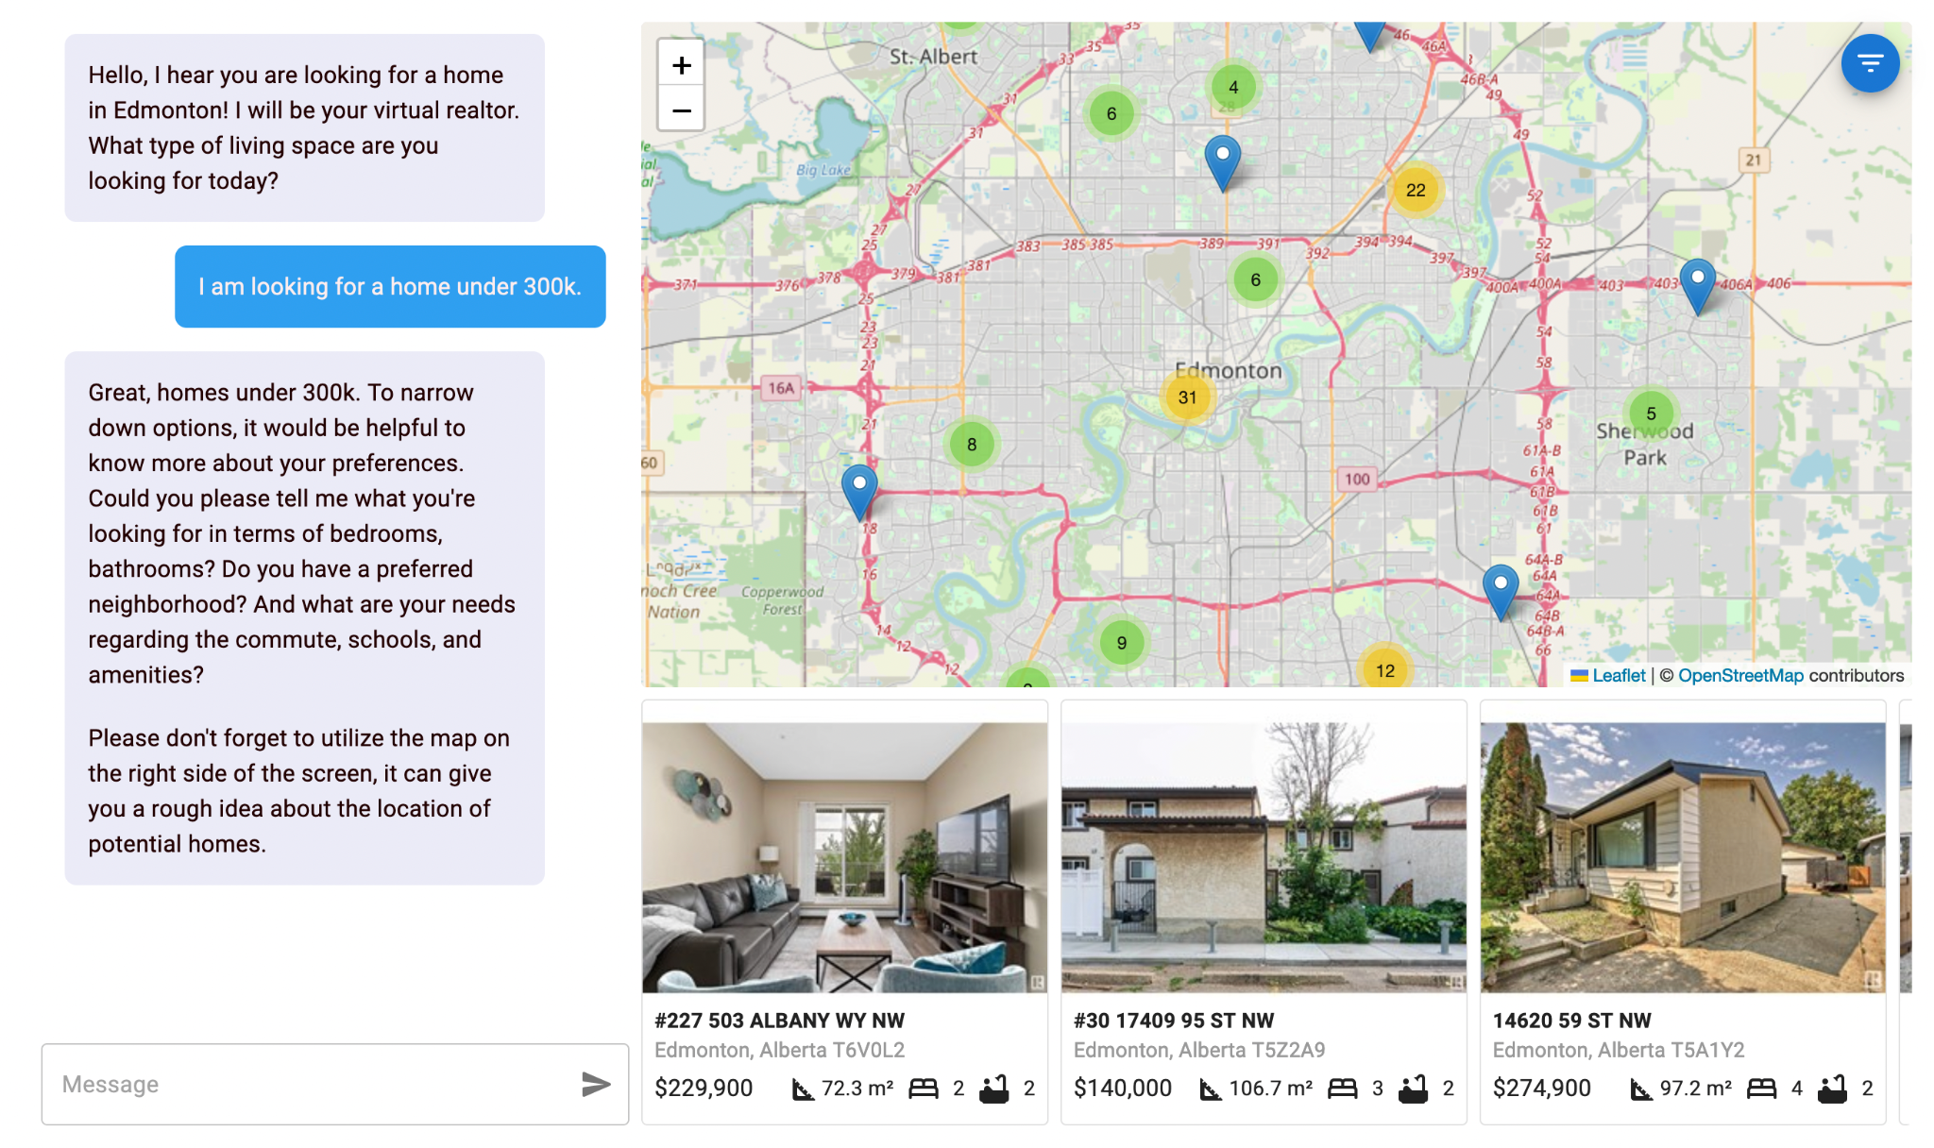
Interface
Notes:
That is why we chose to create REA for this hackathon. The virtual realtor provides an interactive map combined with an AI-powered chatbot, which listens to the user’s story, deduces the user’s needs through natural conversation, and returns a list of houses which seem suitable based on the user’s needs. As the user continues chatting, REA will automatically narrow down their search results after each message, as you provide more and more information to the chatbot.

Slide 7
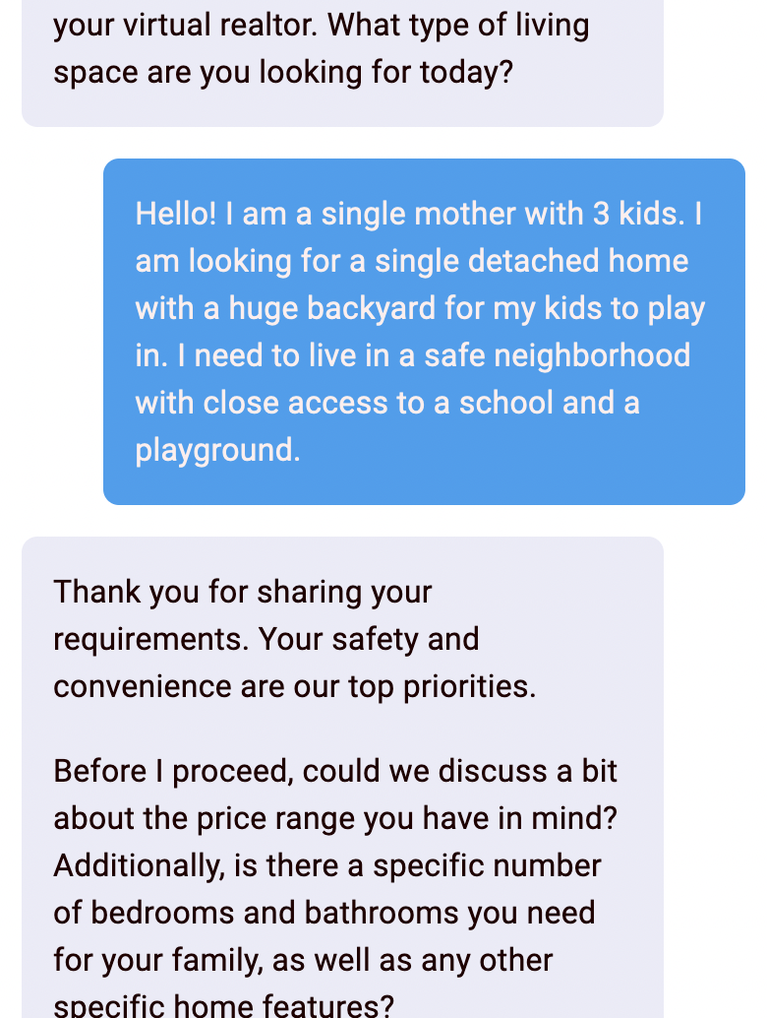
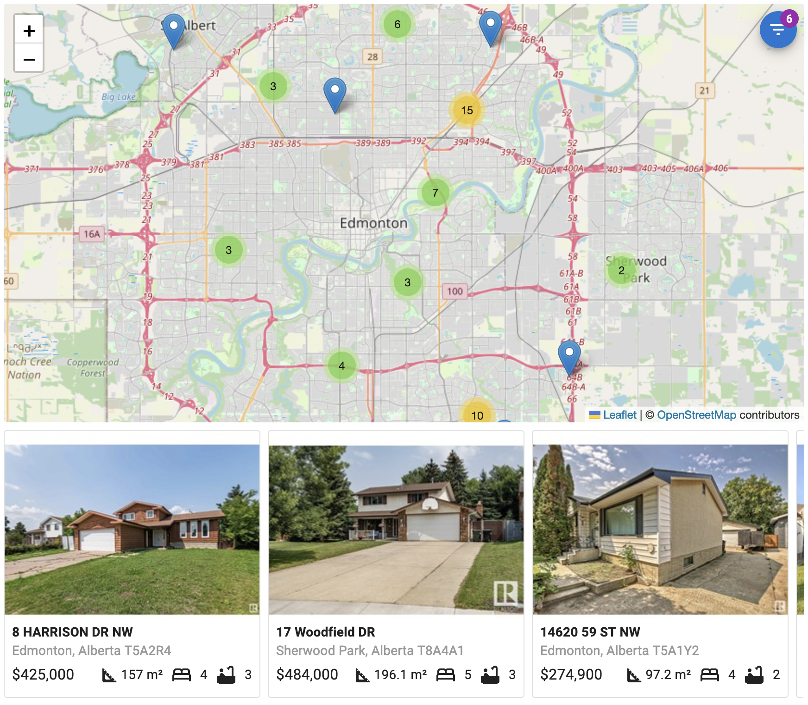
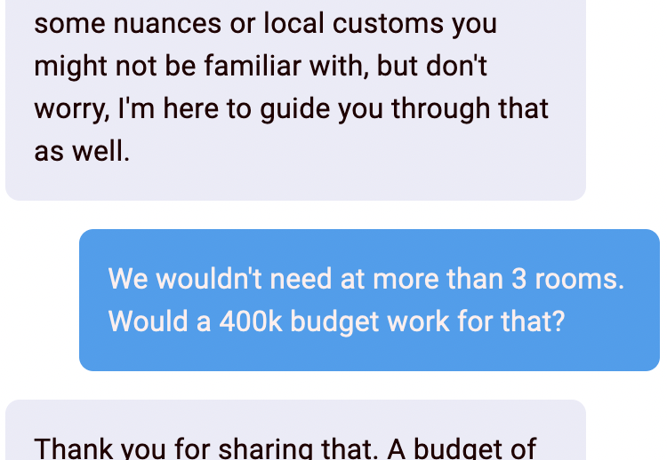
Implementation
… or how we go from a conversation, to a list of homes.

Slide 8

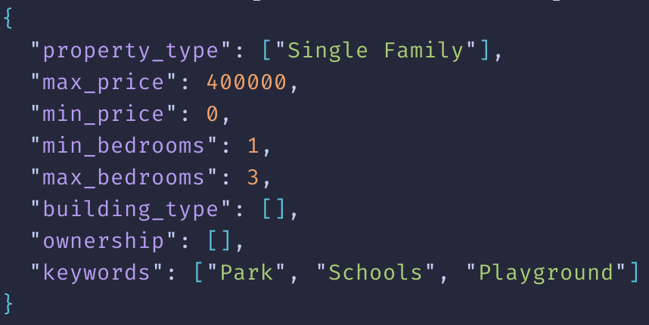
Implementation
Observer
(Extracts intent)
Assistant
(Conversational)

Slide 9
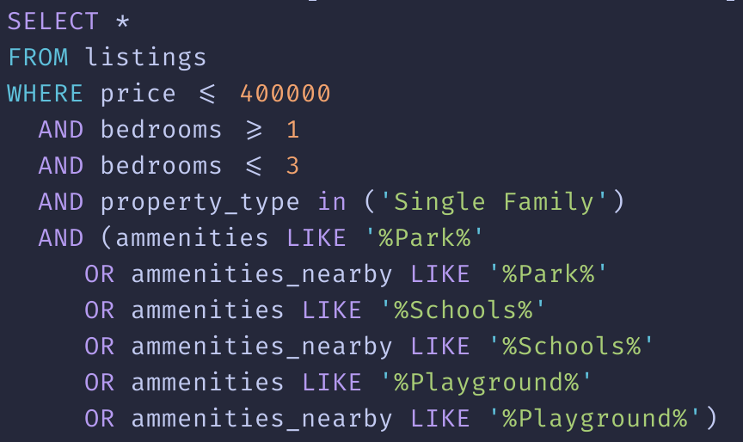
Implementation
Backend
PostgreSQL

Slide 10
Future Developments
Fine-tuning answers using cleaned, high-quality, sentiment data from forums/websites like reddit, facebook, twitter etc
Gather neighborhood data (limited by Realtor.ca’s policies)
Built-in Browser Extension
Notes:
To have a more realistic interaction for the user
Partner with real estate companies for more options presented to users
The idea is to use REA so searching on existing real estate websites will be simplified

Slide 11
Rea: Your Virtual Real Estate Agent

Slide 12
Thank You
Questions? Comments?

